Slide 1
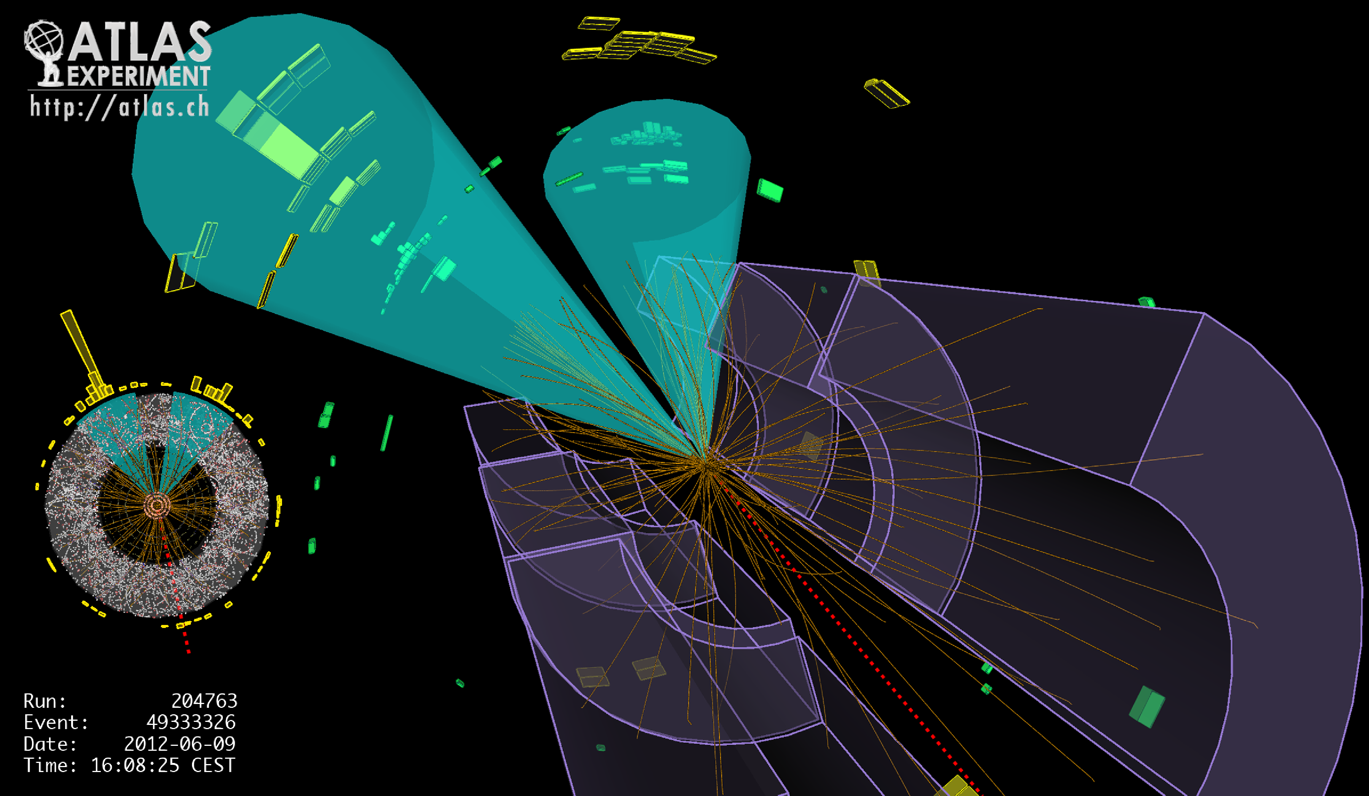
Lecture #10
Prof. Dr. Florencia Canelli
Universität Zürich
Elementary particle physics - PHY451
HS2016

Slide 2
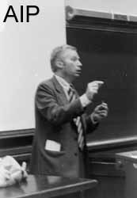
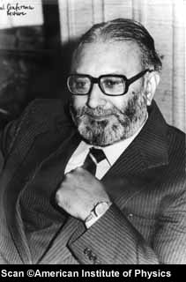
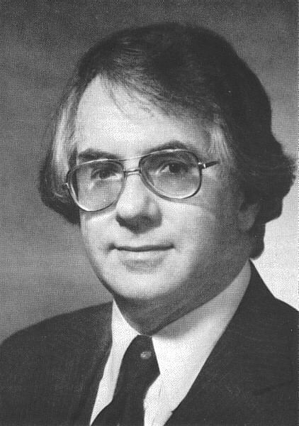
Formulation of a Unified Electroweak Theory
1964-1966
4 intermediate spin 1 interaction carriers (“bosons”):
the photon (γ)
responsible for all electromagnetic processes
three weak, heavy bosons W⁺ W– Z
W± responsible for processes with electric charge transfer = ±1
(Charged Current processes)
S. Weinberg
Examples:
n → p e– ν : n → p + W– followed by W– → e– ν
μ⁺ → e⁺ ν_{e} ν_{μ} : μ⁺ → ν_{μ} + W⁺ followed by W⁺ → e⁺ ν_{e}
A. Salam
Z responsible for weak processes with no electric charge transfer
(Neutral Current processes)
PROCESSES NEVER OBSERVED BEFORE
Require neutrino beams to search for these processes, to remove
the much larger electromagnetic effects expected with charged
particle beams
S. Glashow

Slide 3
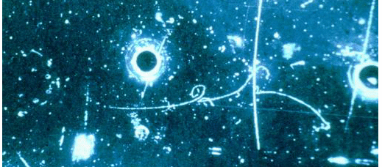
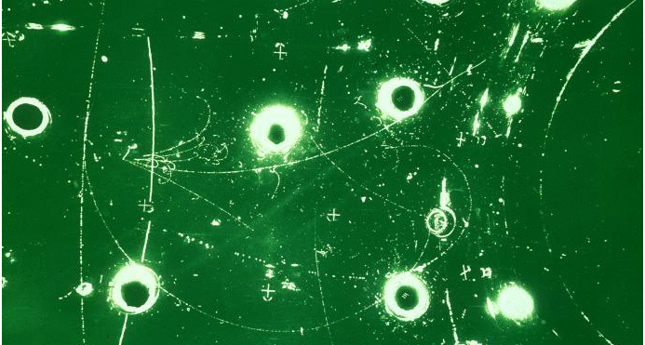
First observation of Neutral Current processes in the heavy liquid bubble chamber Gargamelle at the CERN PS (1973)
Example of
ν_{μ} + e– → ν_{μ} + e–
(elastic scattering)
Recoil electron
energy = 400 MeV
( ν_{μ} beam from π– decay
in flight)
Example of
ν_{μ} + p (n) → ν_{μ} + hadrons
(inelastic interaction)
( ν_{μ} beam from π⁺ decay
in flight)

Slide 4
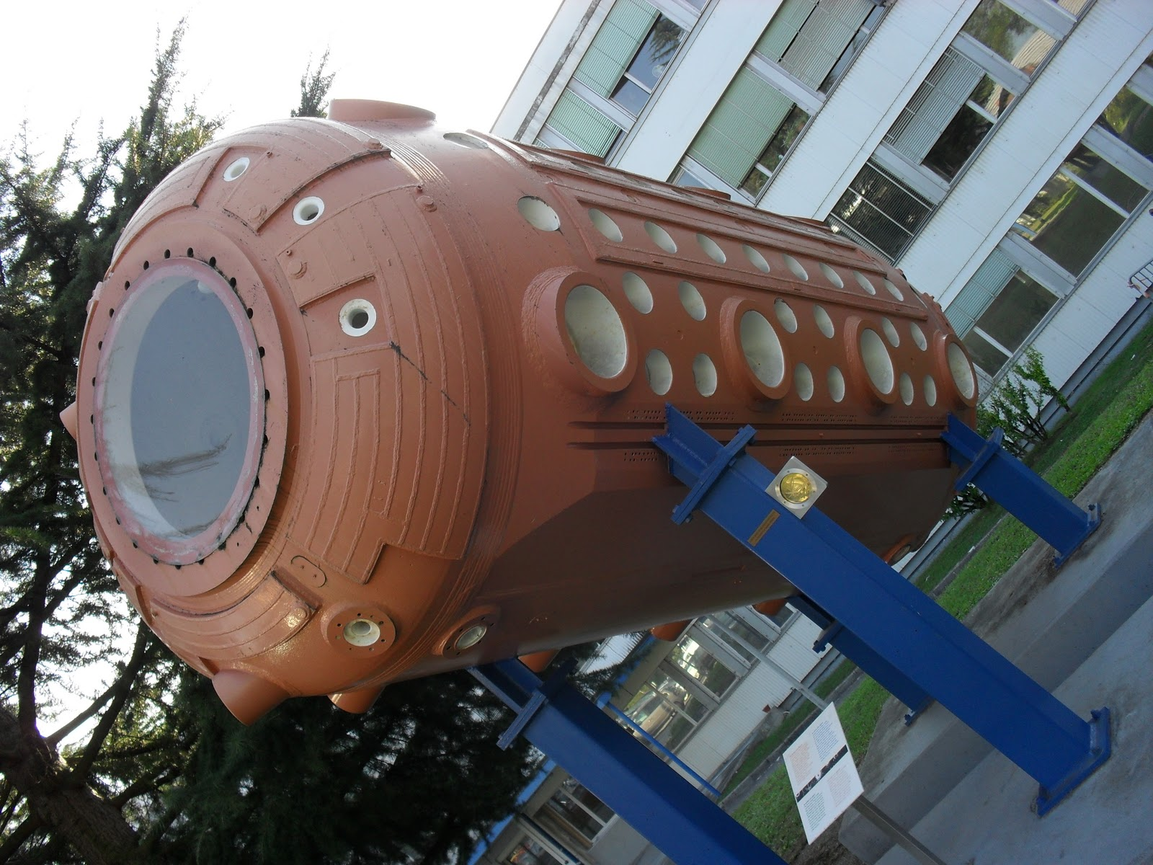
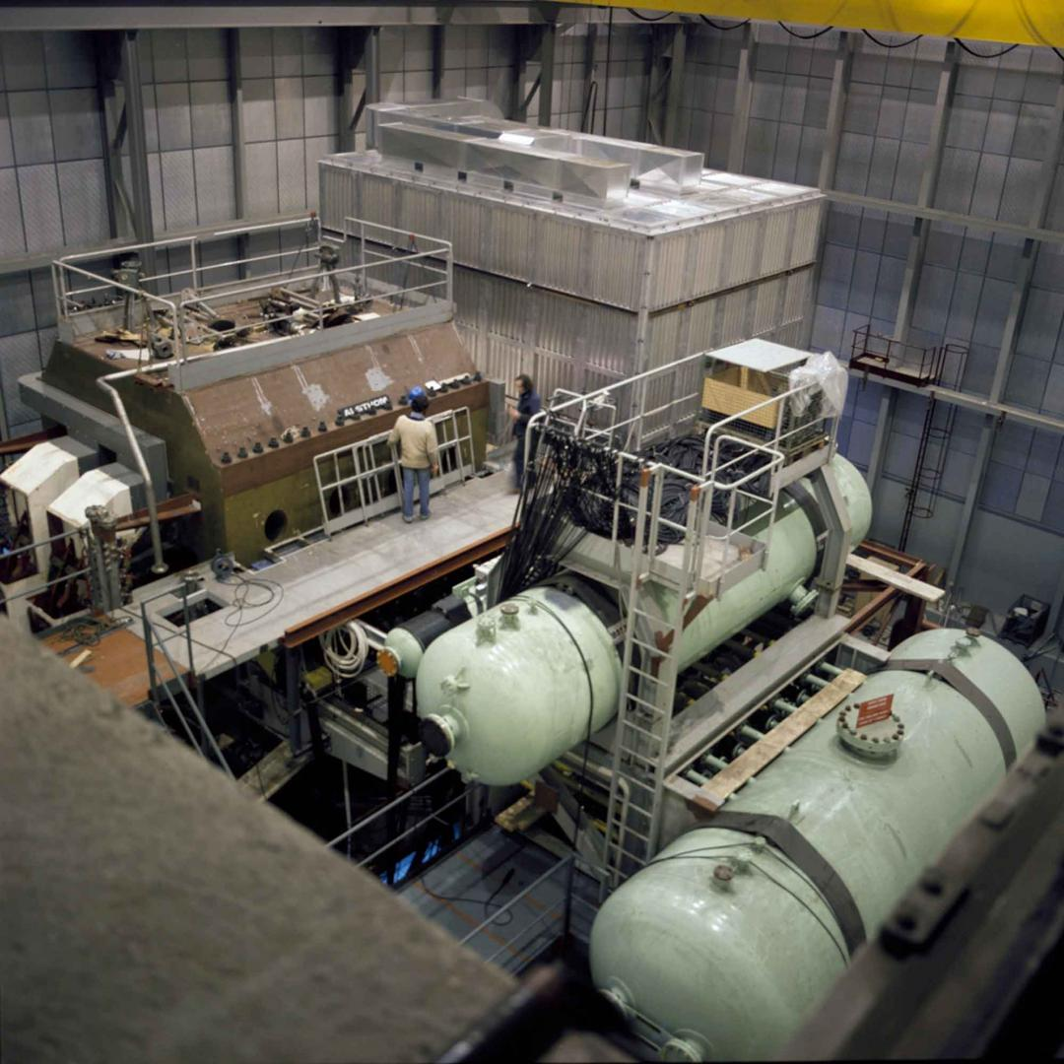

Gargamelle
CERN Courier

Slide 5
Searching for Z and W bosons
Measured rates of Neutral Current events ⇒ estimate of the W and Z masses
(not very accurately, because of the small number of events):
M_{W} ≈ 70 – 90 GeV/c² ; M_{Z} ≈ 80 – 100 GeV/c²
too high to be produced at any accelerator in operation in the 1970’s
1975: Proposal to transform the new 450 GeV CERN proton
synchrotron (SPS) into a proton – antiproton collider (C. Rubbia)
p
p
Beam energy = 315 GeV ⇒ total energy in the centre-of-mass = 630 GeV
Beam energy necessary to achieve the same collision energy on a proton at rest :
E = 210 TeV
Production of W and Z by quark – antiquark annihilation:

Slide 6
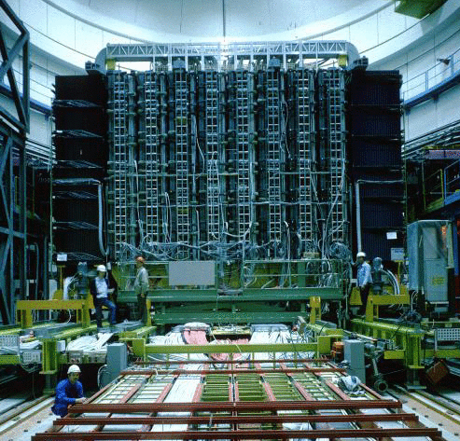
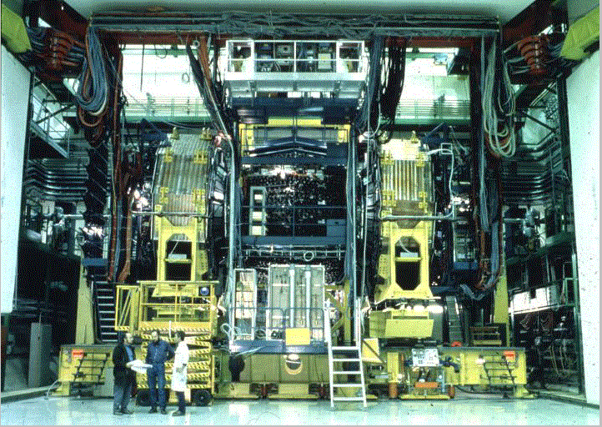
UA1 and UA2 experiments (1981 – 1990)
Search for W± → e± + ν (UA1, UA2) ; W± → μ± + ν (UA1)
Z → e⁺e– (UA1, UA2) ; Z → μ⁺ μ– (UA1)
UA2: non-magnetic,
calorimetric detector
with inner tracker
UA1: magnetic volume with trackers,
surrounded by ”hermetic” calorimeter
and muon detectors

Slide 7
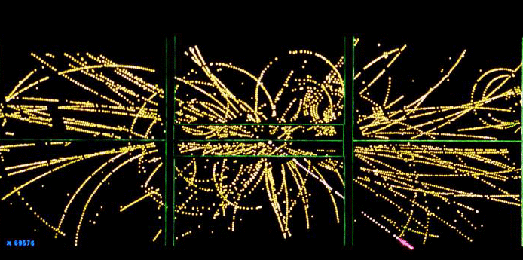
One of the first W → e + ν events in UA1
48 GeV electron
identified by
surrounding calorimeters

Slide 8
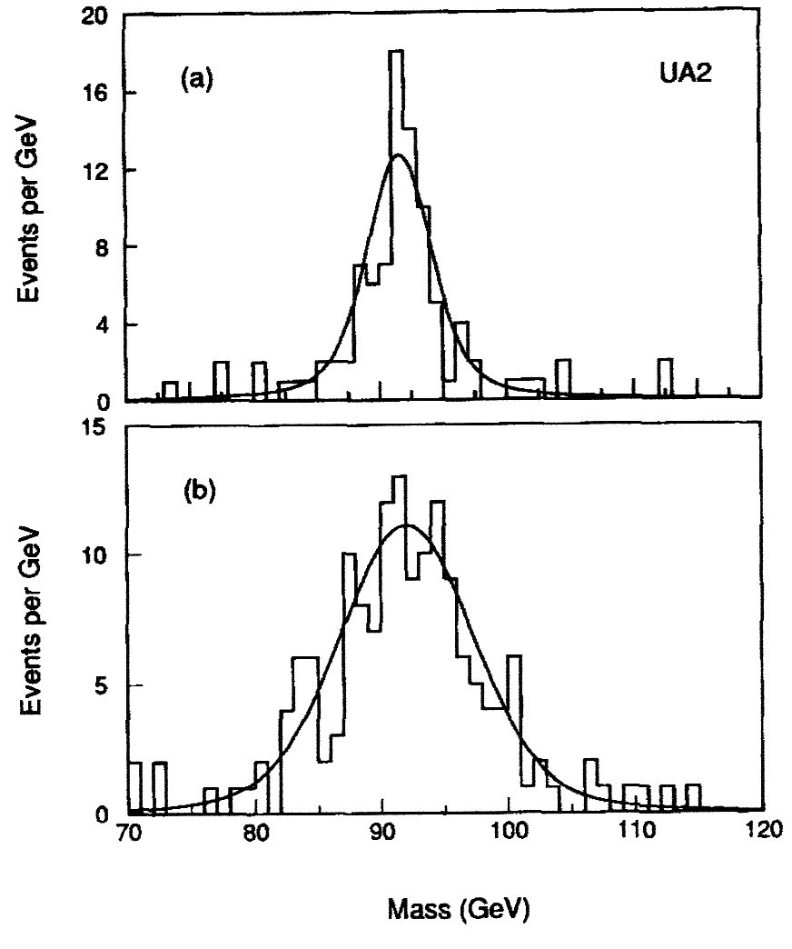
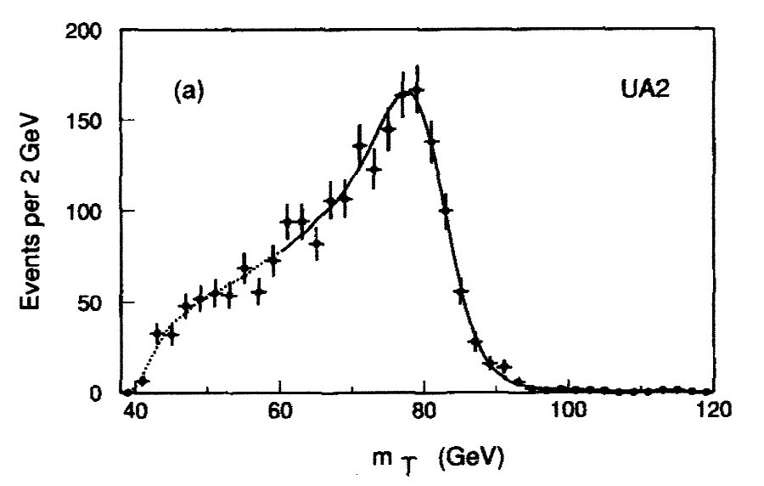
UA2 final results
Events containing two high-energy electrons:
Distributions of the “invariant mass” M_{ee}
(for Z → e⁺e– M_{ee} = M_{Z})
Events containing a single electron with large
transverse momentum (momentum component
perpendicular to the beam axis) and large missing
transverse momentum (apparent violation of
momentum conservation due to the escaping neutrino
from W → eν decay)
m_{T} (“transverse mass”): invariant mass of the electron – neutrino
pair calculated from the transverse components only
M_{W} is determined from a fit to the m_{T} distribution: M_{W} = 80.35 ± 0.37 GeV/c²

Slide 9
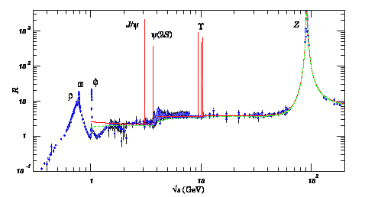
e⁺e– colliders at higher energies
R
Q = 2E (GeV)
e⁺e– → Z → q q
e⁺e– → b b
(the 5th quark: e = −1/3)

Slide 10
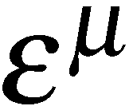
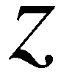
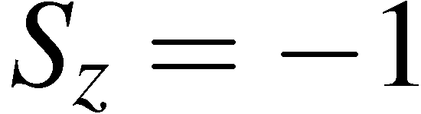
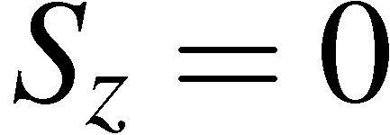
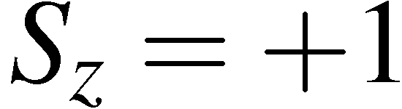
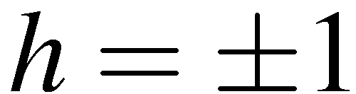
Boson polarization states
Decays of W and Z bosons
A real (i.e. not virtual) massless spin-1 boson can exist in two transverse
polarization states, a massive spin-1 boson also can be longitudinally polarized
Boson wave-functions are written in terms of the polarization four-vector
For a spin-1 boson travelling along the z-axis, the polarization four vectors are:
transverse
longitudinal
transverse
Longitudinal polarization isn’t present for on-shell massless particles, the photon
can exist in two helicity states (LH and RH circularly polarized light)

Slide 11
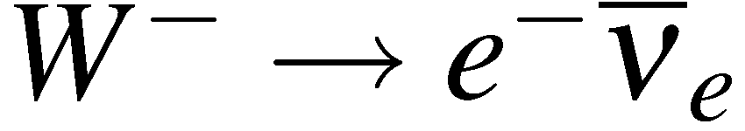
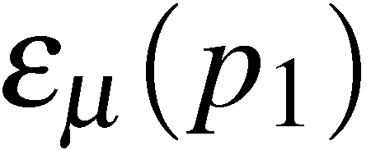
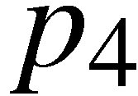
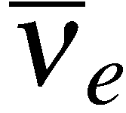
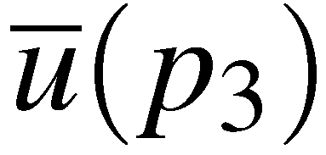

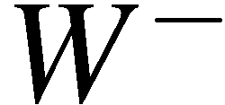
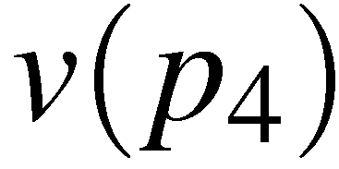

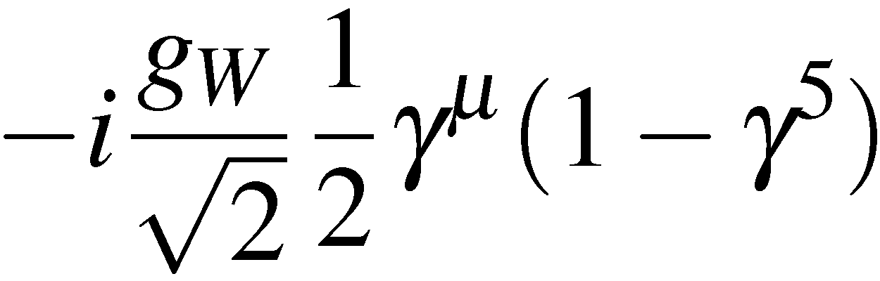
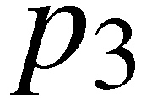
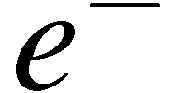
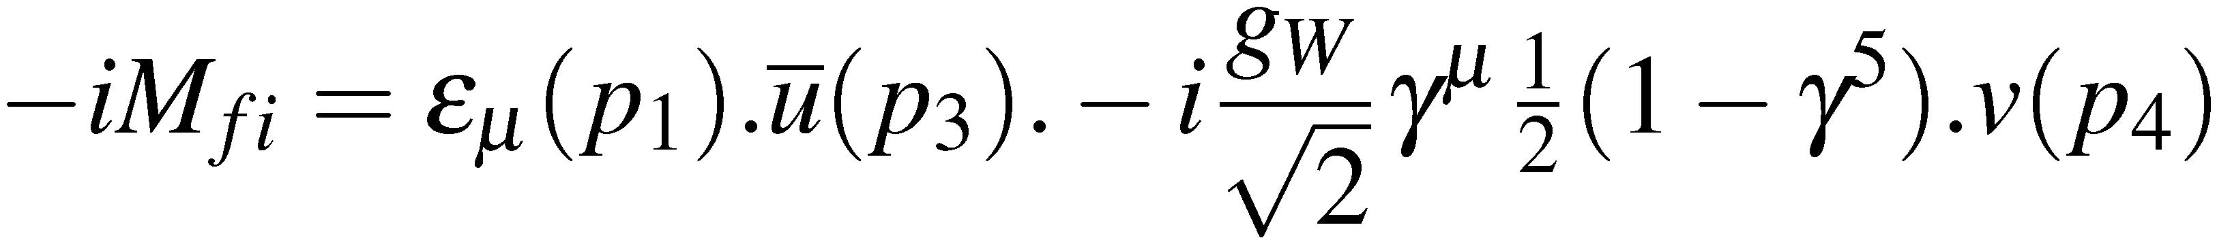
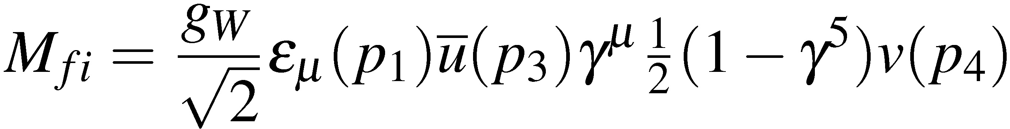

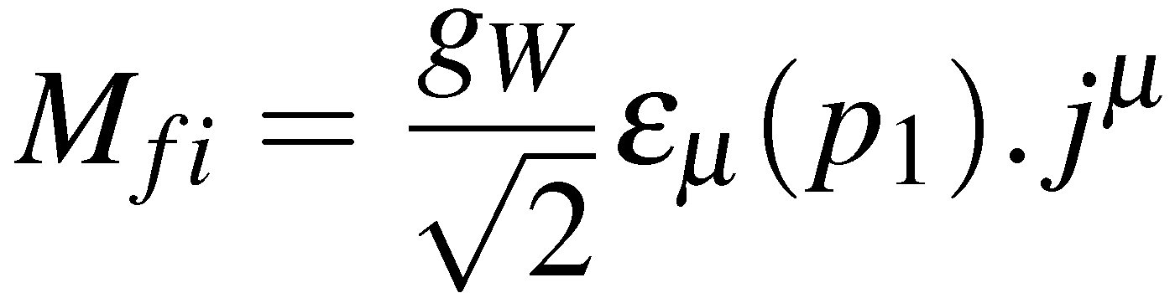
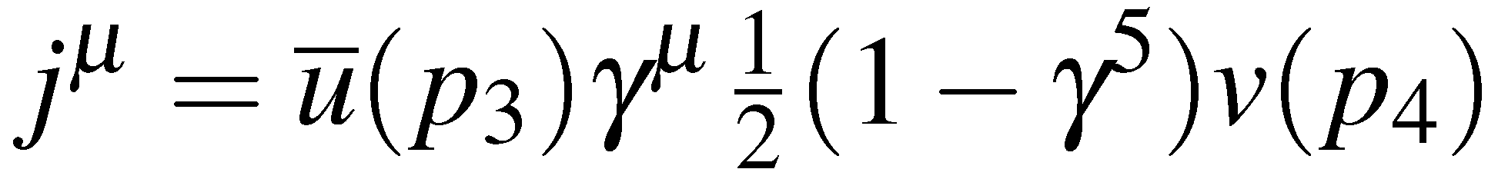
W boson decay
To calculate the W-Boson decay rate first consider
Want matrix element for :
Incoming W-boson :
Out-going electron :
Out-going :
Vertex factor :
Note, no
propagator
This can be written in terms of the four-vector scalar product of the W-boson
polarization and the weak charged current
with

Slide 12
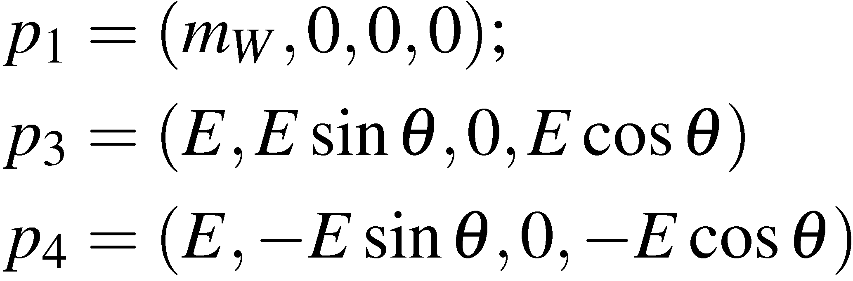
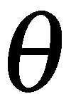
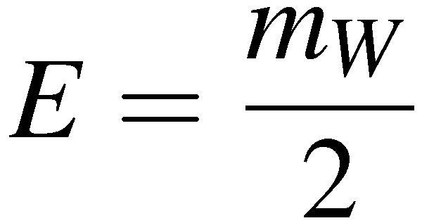
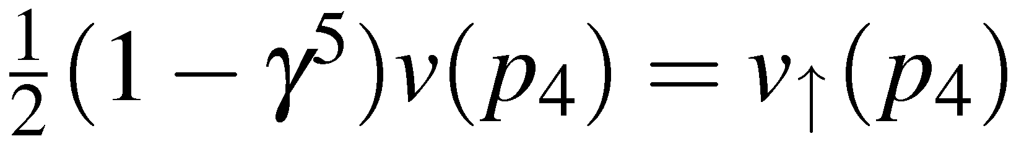
W-Decay: the lepton current
First consider the lepton current
Work in Centre-of-Mass frame
with
In the ultra-relativistic limit only LH particles and RH anti-particles participate
in the weak interaction so
Note:
Chiral projection operator
“Helicity conservation”

Slide 13
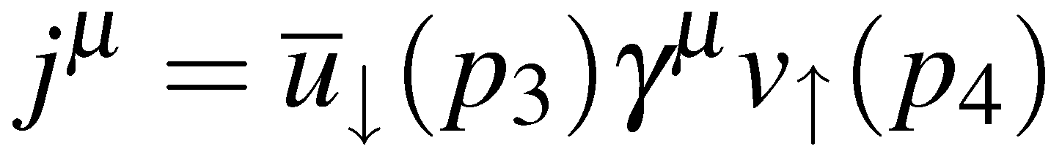
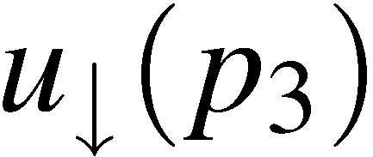
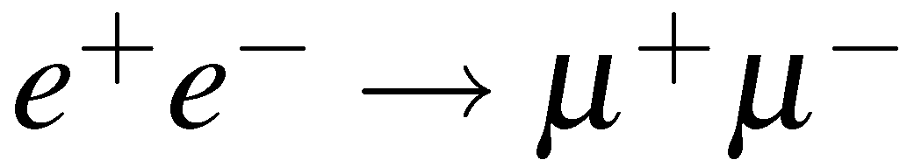
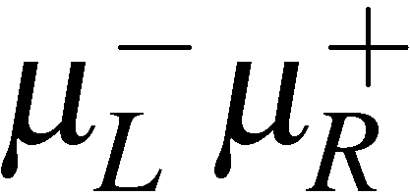
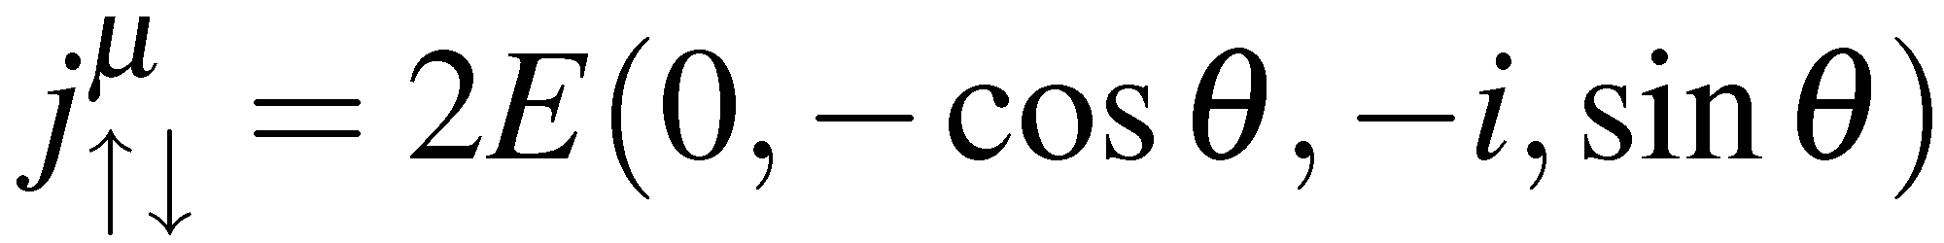
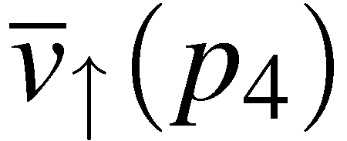
W-Decay: the lepton current
We have already calculated the current
when considering
From page 128 we have for
For the charged current weak Interaction we only have to consider this single
combination of helicities
and the three possible W-Boson polarization states:

Slide 14
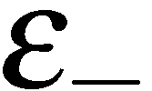

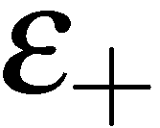
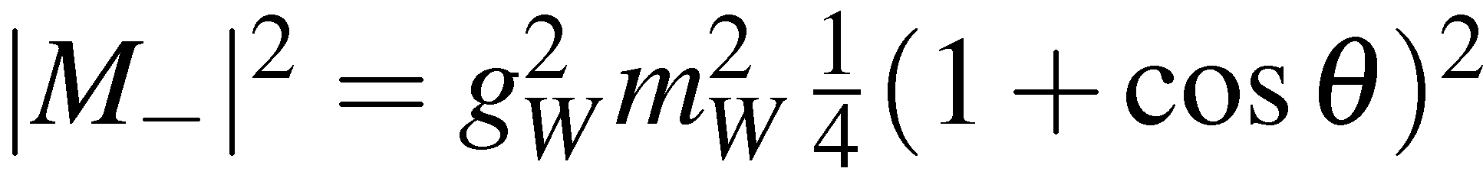
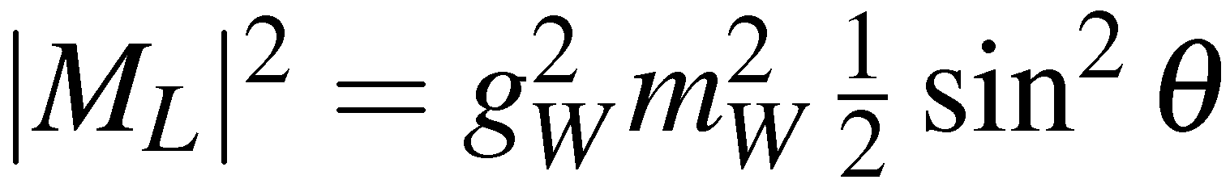
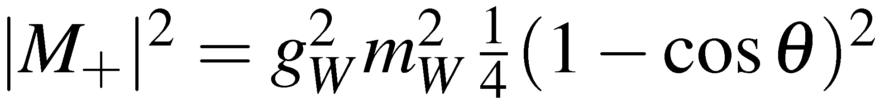
W-Decay: the lepton current
For a W-boson at rest these become:
Can now calculate the matrix element for the different polarization states
with
Decay at rest : E_{e} = E_{ν} = m_{W}/2
giving

Slide 15
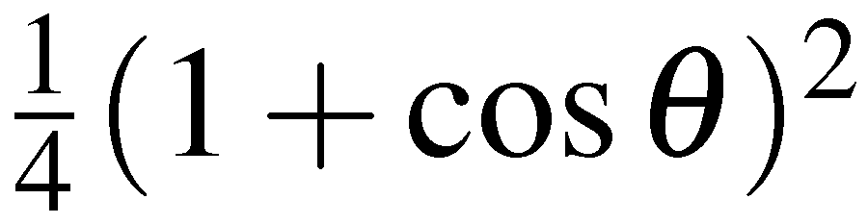




W-Decay: the lepton current
The angular distributions can be understood in terms of the spin of the particles
M₋
M_{L}
M₊
-1
cosθ
+1
-1
cosθ
+1
-1
cosθ
+1
The differential decay rate (see page 26) can be found using:
where p* is the C.o.M momentum of the final state particles, here

Slide 16






W-Decay: the lepton current
Hence for the three different polarisations we obtain:
Integrating over all angles using
Gives
The total W-decay rate is independent of polarization; this has to be the case
as the decay rate cannot depend on the arbitrary definition of the z-axis
For a sample of unpolarized W boson each polarization state is equally likely,
for the average matrix element sum over all possible matrix elements and
average over the three initial polarization states
For a sample of unpolarized W-bosons, the decay is isotropic (as expected)

Slide 17



















For this isotropic decay
The calculation for the other decay modes (neglecting final state particle masses)
is same. For quarks need to account for colour and CKM matrix. No decays to
top – the top mass (175 GeV) is greater than the W-boson mass (80 GeV)
Unitarity of CKM matrix gives, e.g.
Hence
and thus the total decay rate :
Experiment: 2.14±0.04 GeV
(our calculation neglected a 3% QCD
correction to decays to quarks )

Slide 18







From W and Z
The W± bosons carry the EM charge - suggestive Weak are EM forces are related.
W bosons can be produced in e⁺e⁻ annihilation
With just these two diagrams there is a problem:
the cross section increases with C.o.M energy
and at some point violates QM unitarity
UNITARITY VIOLATION: when QM calculation gives larger
flux of W bosons than incoming flux of electrons/positrons
Problem can be “fixed” by introducing a new boson, the Z. The new diagram
interferes negatively with the above two diagrams fixing the unitarity problem
Only works if Z, γ, W couplings are related: need ELECTROWEAK UNIFICATION

Slide 19









SU(2)_{L}: The Weak Interaction
The Weak Interaction arises from SU(2) local phase transformations
where the are the generators of the SU(2) symmetry, i.e the three Pauli
spin matrices
3 Gauge Bosons
The wave-functions have two components which, in analogy with isospin,
are represented by “weak isospin”
The fermions are placed in isospin doublets and the local phase transformation
corresponds to
Weak Interaction only couples to LH particles/RH anti-particles, hence only
place LH particles/RH anti-particles in weak isospin doublets:
RH particles/LH anti-particles placed in weak isospin singlets:
Weak Isospin
Note: RH/LH refer to chiral states

Slide 20










For simplicity only consider
The gauge symmetry specifies the form of the interaction: one term for each
of the 3 generators of SU(2) – [note: here include interaction strength in current]
The charged current W⁺/W⁻ interaction enters as a linear combinations of W₁, W₂
W₁
The W± interaction terms
Express in terms of the weak isospin ladder operators
Origin of in Weak CC
W⁺
corresponds to
Bars indicates
adjoint spinors
which can be understood in terms of the weak isospin doublet

Slide 21





Similarly
W⁻
corresponds to
However have an additional interaction due to W³
expanding this:
NEUTRAL CURRENT INTERACTIONS !

Slide 22













Electroweak Unification
Tempting to identify the as the
However this is not the case, have two physical neutral spin-1 gauge bosons,
and the is a mixture of the two,
Equivalently write the photon and in terms of the and a new neutral
spin-1 boson the
The physical bosons (the and photon field, ) are:
is the weak
mixing angle
The new boson is associated with a new gauge symmetry similar to that
of electromagnetism : U(1)_{Y}
The charge of this symmetry is called WEAK HYPERCHARGE
Q is the EM charge of a particle
I_{W} is the third comp. of weak isospin
3
By convention the coupling to the B_{μ} is
(this identification of hypercharge in terms of Q and I₃ makes all of the following work out)

Slide 23


For this to work the coupling constants of the W³, B, and photon must be related
e.g. consider contributions involving the neutral interactions of electrons:
γ
W³
B
The relation
is equivalent to requiring
Writing this in full:
which works if:
(i.e. equate coefficients of L and R terms)
Couplings of electromagnetism, the weak interaction and the interaction of the
U(1)_{Y} symmetry are therefore related.

Slide 24





The Z boson
In this model we can now derive the couplings of the Z Boson
for the electron
Writing this in terms of weak isospin and charge:
For RH chiral states I₃=0
Gathering up the terms for LH and RH chiral states:
Using: gives
with
i.e.

Slide 25









Unlike for the Charged Current Weak interaction (W) the Z Boson couples
to both LH and RH chiral components, but not equally…
W³ part of Z couples only to
LH components (like W±)
B_{μ} part of Z couples equally to
LH and RH components
Use projection operators to obtain vector and axial vector couplings

Slide 26






























Which in terms of V and A components gives:
with
Hence the vertex factor for the Z boson is:
Using the experimentally determined value of the weak mixing angle:
Fermion

Slide 27
Tuesday lectures
Date | Topic | Student
Sept 27 | Positron (p9) Muon (p29) Pion (p34) | Nici Alex Kevin
Oct 4 | Unstable particles (p65 or p71) Anti-p (p87) or Anti-n (p94) | Lukas Oliver
Oct 11 | Omega-(p144) Parity violation in beta (p163) Parity violation in pions (165) | Magnus Nici Alex
Oct 18 | K-long (p197) CP violation (p206) | Kevin Lukas
Oct 25 | Tau lepton J and Psi Charm meson | Oliver Magnus Nici
Nov 2 | Quarks SLAC Upsilon | Magnus Lukas
Date | Topic | Student
Nov 8 | Jets UA2 Gluons TASSO | Alex Kevin
Nov 15 | Neutral currents Discovery of the W boson | Nici Alex
Nov 22 | Neutrino types Parity
Nov 29 | Discovery of the top quark Top quark mass measurement
Dec 6 | ARGUS CDF (or Belle/Babar)
Dec 13 | Solar Atmospheric
Dec 20 | Higgs discovery by ATLAS or CMS Measurements of Higgs boson properties
From pages from R. Cahn and G. Goldhaber book if available

